Slide 1

Project-Part B: Customer Churn Prediction
MACHINE LEARNING
Submitted by: Satish Kumar

Slide 2
Project Overview
Customer churn, or customer attrition, refers to when a customer ceases their relationship with a company or service provider,
Aims: to build a machine learning model that can predict whether a customer will churn based on their demographic, account, and service-related data.
Predicting customer churn can help organizations take proactive steps to retain customers, thus minimizing revenue loss.
Goal: Predict churn using demographic, account, and service data to improve retention.

Slide 3
Problem Statement & Objective
Objective: to develop a classification model to predict customer churn.
Using demographic data (such as gender, senior citizen status, and tenure), along.
With information about the services, they use (such as internet service, phone service, and online security),
Help the company identify high-risk customers and design retention strategies.

Slide 4

1. Data Collection Dataset Information: CSV File Load the dataset and IMPORT Python Libraries
Dataset: Customer data
Includes:
- Demographics
- Service usage
- Account info
- Payment methods

Slide 5
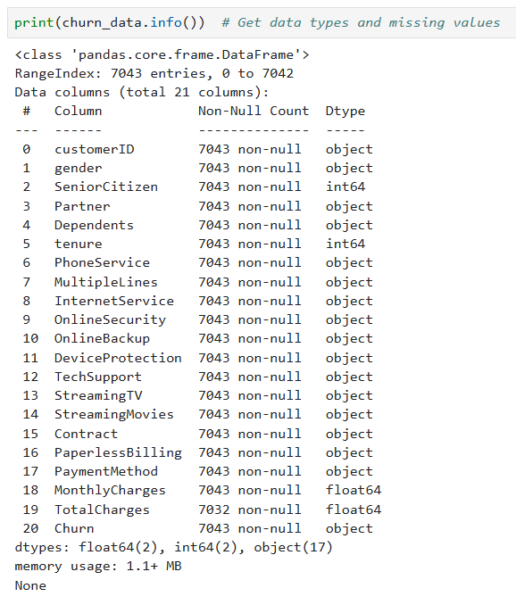
2. Data Cleaning
Finding Missing values
Null values

Slide 6
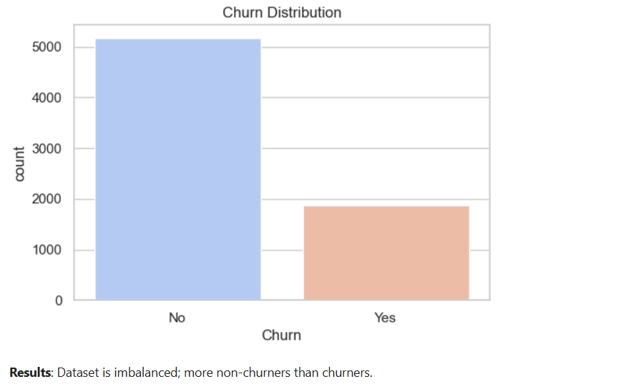
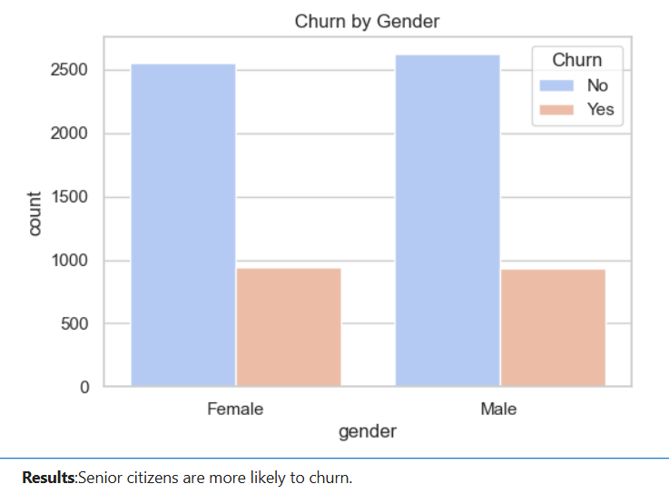
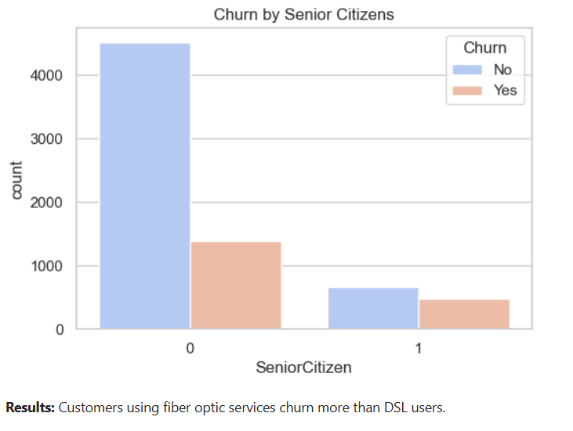
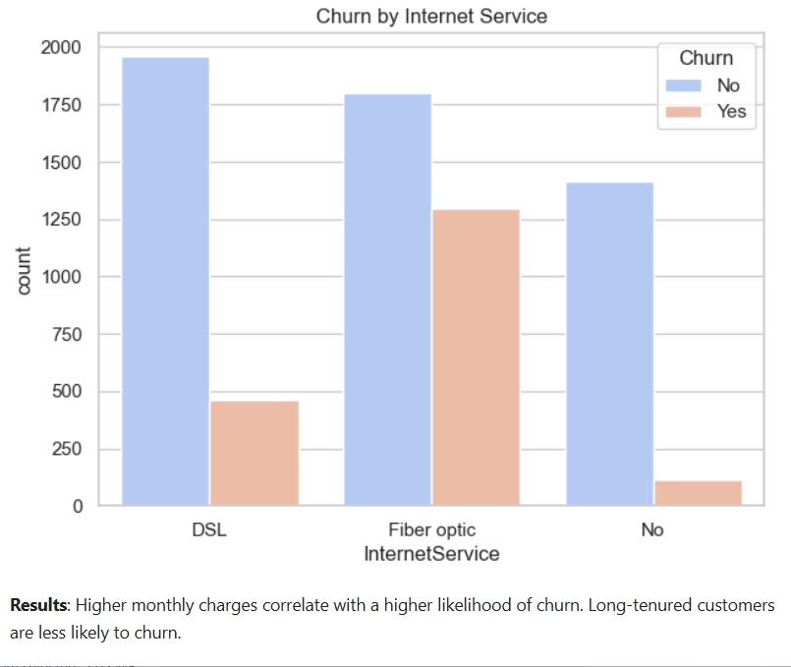
3. Data Exploratory and Analysis

Slide 7
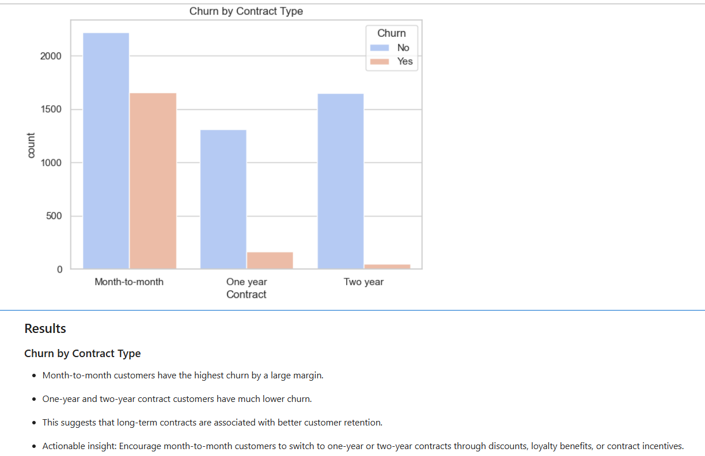
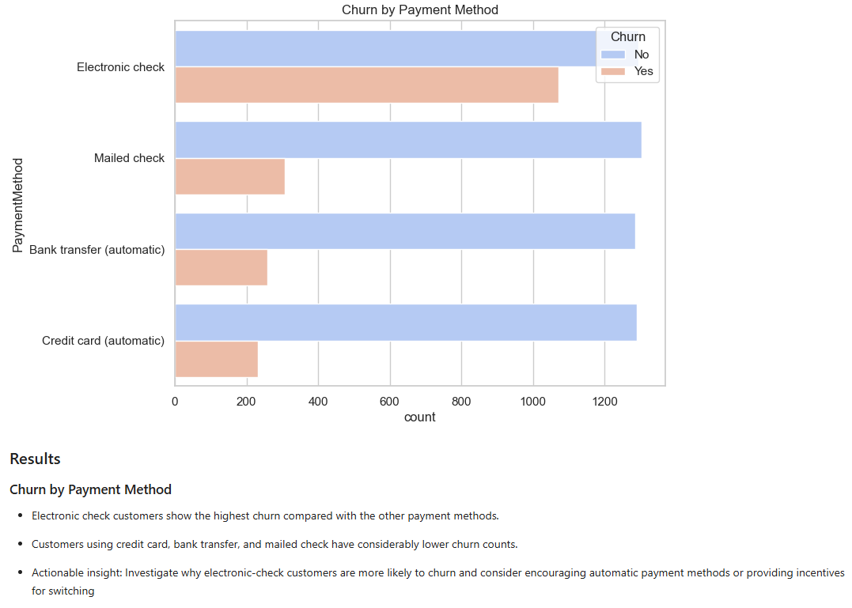
3. Data Processing
Box Plot Graph Analysis
The box plots do not show major extreme outliers in the continuous numerical variables.
Therefore, there is no strong evidence that the continuous variables require aggressive outlier removal.
Senior Citizen is binary and should be treated as a categorical/binary variable rather than as a continuous numerical variable.
Bar Graph Analysis

Slide 8
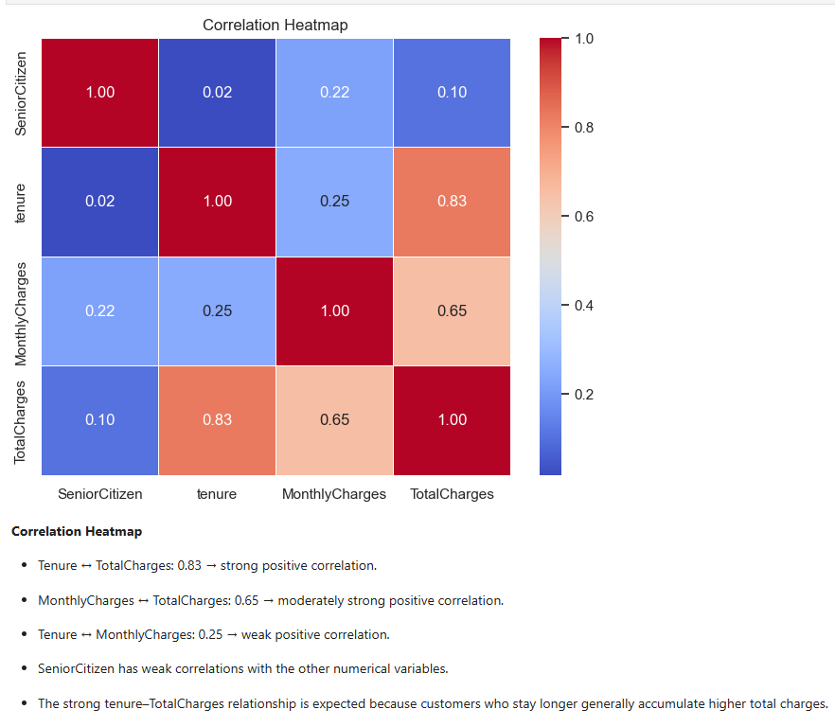
4. Feature Engineering
Fill Missing Values
Correlation Heatmap

Slide 9
5. Model Development
1. Import all Model including SMOTE
2. Select Features and Target
3. Model Training/Testing
4. Preprocessing Pipeline
5. Model Selection Process

Slide 10
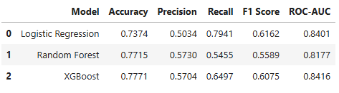
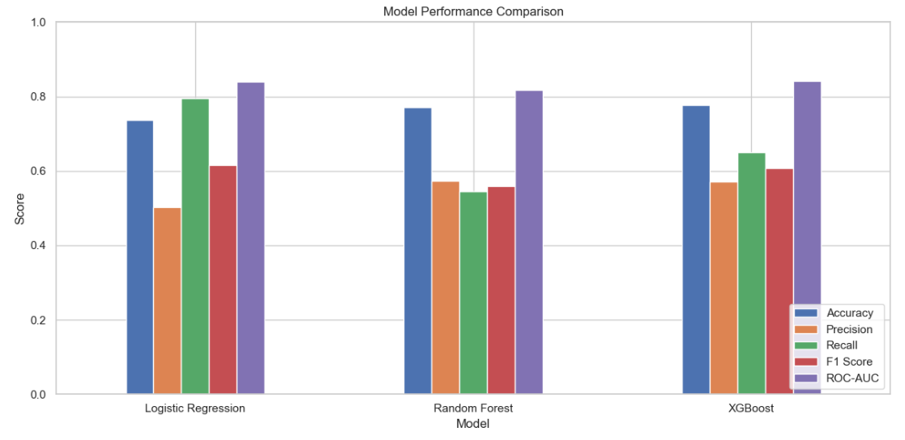
6. Model Selection
Create, Train and Evaluate the 3 Models
Logistic Regression: 73.74%
Random Forest: 77.15%
XGBoost (SMOTE): 77.71%

Slide 11
7. Model Comparison
Evaluation Comparison:
XGBoost performed slightly better in terms of accuracy.
Logistic Regression achieved high recall, making it useful when false negatives are costly.
Statistical Method | Accuracy | Precision | Recall | F1-Score | ROC-AUC
Random Forest | 77.15% | 57.30% | 54.55% | 55.89% | 81.77%
XG Boost | 77.71% | 57.04% | 64.97% | 60.75% | 84.16%
Logistic Regression | 73.74% | 50.34% | 79.41% | 61.62% | 84.01%

Slide 12
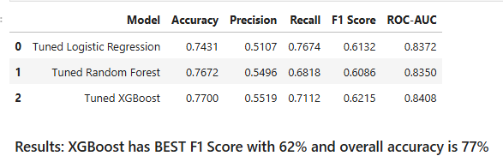
8. Hyperparameter Tuning
Evaluate the Tuned 3 Models
Logistic Regression: 74.31%
Random Forest: 76.72%
XGBoost (SMOTE): 77.00%
Results:
XG Boost has BEST F1 Score with 62% and overall accuracy is 77%

Slide 13
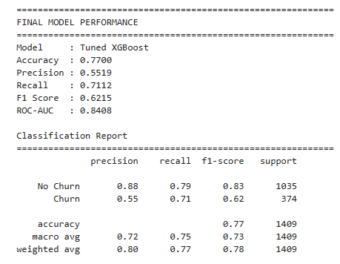
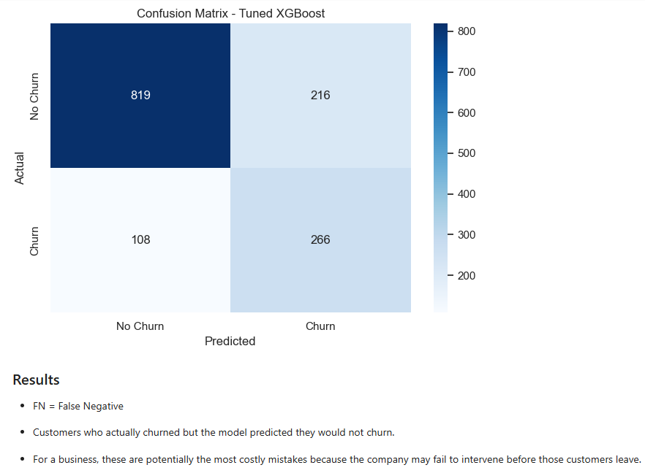
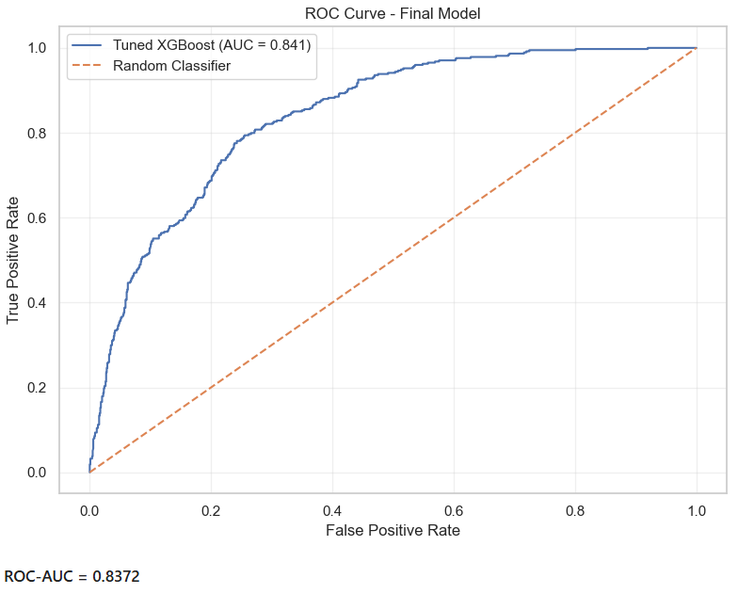
9. Final Model Selection: XG Boost
Model Performance: 77%
Confusion Matrix: False Negative
ROC-AUC Curve: 83.72

Slide 14
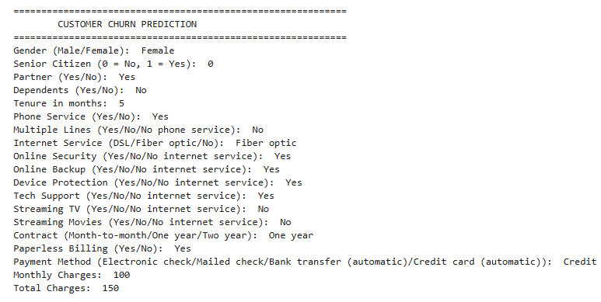
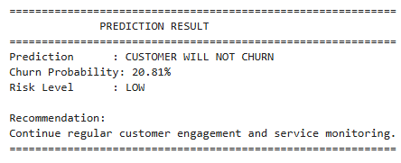
10. Customer Prediction: Result

Slide 15
Key Insights:
1. Customer churn is imbalanced — non-churners are significantly higher than churners, making churn detection more challenging.
2. Senior citizens show higher churn tendency, indicating this group may require additional retention attention.
3. Fiber optic customers have higher churn compared with DSL customers, suggesting possible concerns related to pricing, service quality, or reliability.
4. Customers with higher Monthly Charges tend to churn more, indicating possible price sensitivity.
5. Short-tenure customers are more likely to churn, making the early customer lifecycle an important retention period.
6. Electronic-check users have the highest churn rate among payment methods analyzed.
7. Month-to-month contracts are a major churn-risk segment, as shown by the contract analysis and model results.

Slide 16
Recommendations:
Target short-tenure customers
Encourage longer-term contracts
Improve Fiber Optic service
Address high monthly charges
Promote alternative payment methods
Create targeted senior-citizen retention programs
Use the churn model for targeted campaigns
Monitor churn continuously

Slide 17
THANK YOU

